Slide 1

Noise Pollution and Remediation
Information Security Fundamentals | Environmental Pollution and Remediation
Course: Information Security Fundamentals | Chapter: Environmental Pollution and Remediation | Program: Bachelor of Engineering
DISCOVER · LEARN · EMPOWER
Notes:
Welcome everyone to our session on Noise Pollution. Today we will analyze how sound becomes a pollutant and the engineering solutions to mitigate it. This topic is critical for understanding environmental impacts in our ecosystems. Let us begin by defining the scope of noise as a form of pollution.

Slide 2
Course Outcomes
SLIDE 2 / 14
Course Outcome
CO | BT LEVEL | DESCRIPTION
CO1 | BT4 | Recall, analyze and respond on fundamental environmental principles, such as ecological relationships and conservation strategies
CO2 | BT4 | Understand and analyze the interconnections between human activities and environmental impacts across different ecosystems
CO3 | BT4 | Understand and analyze and apply environmental laws and policies to analyse and propose solutions for real-world environmental challenges.
CO4 | BT2 | Students will analyse data from environmental monitoring programs to assess trends and predict future impacts on ecosystems.
CO5 | BT6 | Interpret, elaborate and propose various tools, design and innovative strategies for sustainable development and environmental conservation initiatives in securing the planet.
Chandigarh University
2 / 14
Notes:
This lecture directly addresses Course Outcome 2. We will analyze how human activities like traffic and industry create noise that impacts various ecosystems. You will learn to connect these activities to specific environmental consequences. This analysis is the core of our learning objective today.

Slide 3
Learning Objectives
SLIDE 3 / 14
Learning Outcomes
1
Analyze the physical characteristics and sources of noise pollution
2
Evaluate the health impacts of noise on human and animal populations
3
Calculate noise levels using decibel addition and subtraction principles
4
Propose engineering controls for noise reduction in industrial settings
5
Assess the effectiveness of various noise remediation strategies
Chandigarh University
3 / 14
Notes:
By the end of this session, you will be able to analyze noise sources and their physical properties. You will evaluate how noise affects health and calculate sound levels mathematically. We will also focus on proposing and assessing engineering controls for remediation. These skills are essential for environmental engineering practice.

Slide 4
Lecture
SLIDE 4 / 14
Defining Noise as Pollution
1
Noise is unwanted or harmful sound that disrupts normal activities
2
It is a form of energy pollution that does not leave physical residue
3
Unlike chemical pollutants, noise disappears immediately when the source stops
4
It is measured in decibels (dB) which is a logarithmic scale
5
The perception of noise varies based on frequency and duration
6
Excessive noise is classified as pollution when it exceeds regulatory limits
7
It causes both physical hearing loss and psychological stress in humans
Chandigarh University
4 / 14
Notes:
Noise is defined as unwanted sound that causes disturbance. Unlike chemical waste, it is energy that dissipates quickly. However, its impact is immediate and severe. For example, a sudden loud explosion can cause instant hearing damage. We measure this using the decibel scale which is logarithmic.

Slide 5
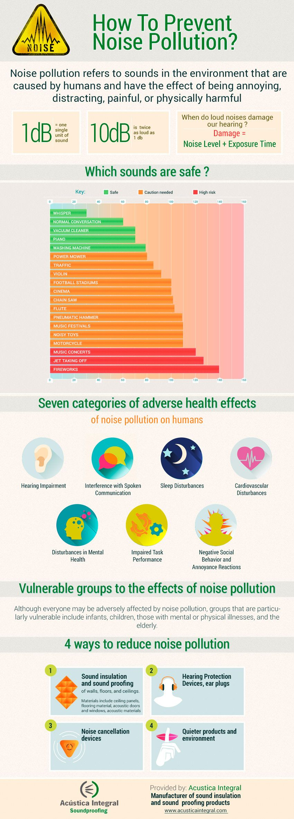
Lecture
SLIDE 5 / 14
Sources of Noise Pollution
1
Transportation sources include road traffic, aircraft, and railway operations
2
Industrial sources involve machinery, generators, and construction equipment
3
Recreational sources include loud music, fireworks, and sporting events
4
Domestic sources include household appliances and loud conversations
5
Urbanization increases noise levels by reducing natural sound barriers
6
High-density traffic creates continuous background noise in cities
7
Construction activities generate intermittent but high-intensity noise bursts
Noise pollution: what it is, how it affects us and how to measure it (source: kunakair.com)
Chandigarh University
5 / 14
Notes:
The primary sources of noise are transportation and industry. Road traffic is the most common source in urban areas. Aircraft and railways contribute significantly to regional noise levels. Construction and recreational activities add intermittent high-intensity noise. Understanding these sources helps in planning effective remediation strategies.

Slide 6
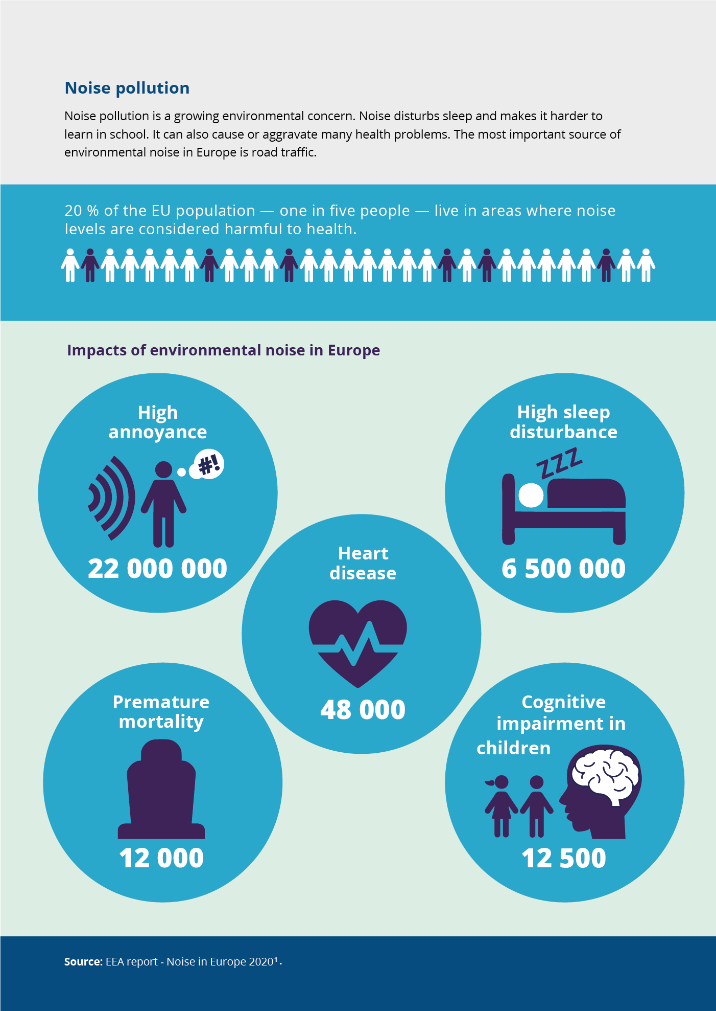
Lecture
SLIDE 6 / 14
Health Impacts of Noise
1
Prolonged exposure causes permanent sensorineural hearing loss in humans
2
Noise induces stress responses leading to hypertension and heart disease
3
It disrupts sleep patterns causing fatigue and reduced cognitive performance
4
Children suffer from impaired learning and reading comprehension due to noise
5
Wildlife experiences altered communication and breeding patterns from noise
6
Psychological effects include irritability, anxiety, and reduced quality of life
7
Acoustic trauma can occur from sudden extremely loud sounds
Noise pollution | Maps and charts | European Environment Agency (EEA) (source: www.eea.europa.eu)
Chandigarh University
6 / 14
Notes:
Noise pollution has severe health implications beyond just hearing loss. It triggers stress responses that can lead to hypertension and heart disease. Sleep disruption is a major issue affecting cognitive performance. For instance, students near airports often show lower reading scores. Wildlife also suffers from altered communication and breeding patterns.

Slide 7
Lecture
SLIDE 7 / 14
Measurement and Decibel Scale
1
Sound pressure level is measured in decibels (dB) using a sound level meter
2
The decibel scale is logarithmic where 10 dB increase equals 10x intensity
3
0 dB represents the threshold of human hearing at 1000 Hz
4
120 dB is the threshold of pain for the human ear
5
A-weighting (dBA) filters frequencies to match human hearing sensitivity
6
Leq represents the equivalent continuous sound level over a period
7
Lmax captures the maximum instantaneous sound level during an event
Chandigarh University
7 / 14
Notes:
We measure noise using a sound level meter in decibels. The scale is logarithmic, meaning a 10 dB increase represents a tenfold increase in intensity. For example, 60 dB is ten × more intense than 50 dB. We use A-weighting to match human hearing sensitivity. This helps us assess the actual impact on people.

Slide 8
Numerical Example
SLIDE 8 / 14
Decibel Addition
GOVERNING EQUATION
Formula: L_total = L_single + 10 × log₁₀(n)
n is number of sources
EXAMPLE
Two machines each producing 80 dB result in 83 dB total
CALCULATION
80 + 10 × log₁₀(2) = 80 + 10 × 0.301 = 83.01 dB
PITFALL
Students often incorrectly add decibels arithmetically (80 + 80 = 160)
• Two identical noise sources do not double the decibel reading
• Adding a third machine increases level to 84.77 dB
• Adding a fourth machine increases level to 86.02 dB
Chandigarh University
8 / 14
Notes:
Let's work through a numerical example. If you have two machines each producing 80 dB, the total is not 160 dB. Using the formula, we add 10 × the log of the number of sources. So 80 plus 10 × log of 2 equals 83 dB. A common pitfall is adding decibels arithmetically which is incorrect. Always use the logarithmic addition formula.

Slide 9
Numerical Example
SLIDE 9 / 14
Noise Reduction
GOVERNING EQUATION
Formula: ΔL = L_initial - L_final
EXAMPLE
A barrier reduces noise from 90 dB to 75 dB
CALCULATION
90 - 75 = 15 dB reduction achieved
CALCULATION
Intensity ratio = 10^(15/10) = 10^1.5 ≈ 31.6
PITFALL
Confusing decibel reduction with linear intensity reduction
• Noise reduction is calculated as the difference between initial and final levels
• A 15 dB reduction represents a 31.6 × decrease in sound intensity
Noise pollution: what it is, how it affects us and how to measure it (source: kunakair.com)
Chandigarh University
9 / 14
Notes:
Consider a noise barrier reducing sound from 90 dB to 75 dB. The reduction is 15 dB. This might seem small, but it represents a massive decrease in intensity. A 15 dB reduction means the intensity is 31.6 × lower. Students often confuse the decibel value with linear intensity. Remember that decibels are logarithmic.

Slide 10
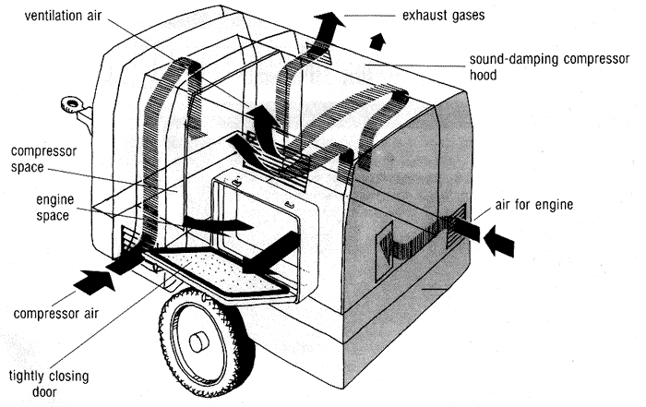
Engineering Controls
SLIDE 10 / 14
Source Reduction
1
Replace noisy equipment with quieter, modern technology
2
Maintain machinery regularly to prevent wear-induced noise generation
3
Use vibration isolators to prevent structure-borne noise transmission
4
Enclose noisy machines in soundproof housings or enclosures
5
Install mufflers and silencers on exhaust and ventilation systems
6
Operate noisy equipment during non-sensitive hours to reduce impact
7
Implement administrative controls like rotating shifts to limit exposure
Source: 800nonoise.com
Chandigarh University
10 / 14
Notes:
The most effective control is at the source. We can replace noisy equipment with quieter alternatives. Regular maintenance prevents noise from worn parts. Enclosing machines in soundproof housings is highly effective. Mufflers on exhaust systems reduce engine noise. Administrative controls like rotating shifts also help limit exposure.

Slide 11
Engineering Controls
SLIDE 11 / 14
Path Interruption
PITFALL
Relying solely on absorption without blocking direct paths
• Install acoustic barriers and walls to block direct sound propagation
• Use sound-absorbing materials on walls and ceilings in enclosed spaces
• Create buffer zones with vegetation to absorb and deflect sound waves
• Design building layouts to place sensitive areas away from noise sources
• Use double-glazed windows to reduce noise transmission into buildings
• Install acoustic curtains and baffles in industrial halls
Chandigarh University
11 / 14
Notes:
When source control is insufficient, we interrupt the path. Acoustic barriers block direct sound propagation effectively. Sound-absorbing materials reduce reverberation in enclosed spaces. Vegetation buffers can absorb and deflect sound waves. Double-glazed windows are essential for residential protection. A common pitfall is relying only on absorption without blocking direct paths.

Slide 12
Engineering Controls
SLIDE 12 / 14
Receiver Protection
PITFALL
Assuming hearing protection is a substitute for engineering controls
• Provide personal protective equipment like earplugs and earmuffs
• Designate quiet zones for rest and recovery from noise exposure
• Implement hearing conservation programs with regular audiometric testing
• Use remote monitoring to reduce human presence in noisy areas
• Install soundproof booths for operators in high-noise environments
• Educate workers on proper use and limitations of hearing protection
Chandigarh University
12 / 14
Notes:
When other controls fail, we protect the receiver. Personal protective equipment like earplugs is essential. Hearing conservation programs with regular testing are mandatory. Remote monitoring reduces human presence in noisy areas. Soundproof booths provide safe workspaces. A critical pitfall is assuming protection replaces engineering controls.

Slide 13
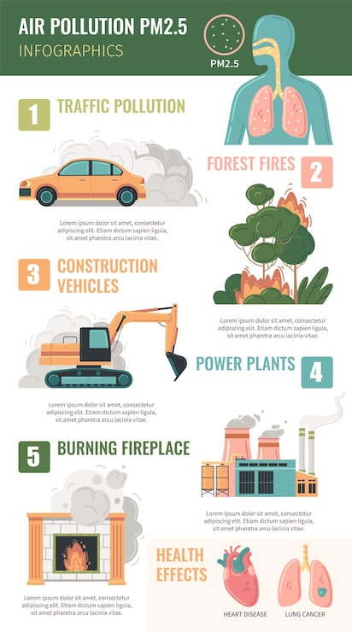
Lecture
SLIDE 13 / 14
Key Takeaways
1
Noise is energy pollution measured on a logarithmic decibel scale
2
Health impacts include hearing loss, stress, and sleep disruption
3
Decibel addition requires logarithmic calculation not arithmetic addition
4
Source reduction is the most effective remediation strategy
5
Engineering controls must be implemented in a hierarchy of effectiveness
Source: img.magnific.com
Chandigarh University
13 / 14
Notes:
To summarize, noise is energy pollution measured in decibels. It causes significant health impacts including hearing loss and stress. Remember that decibel addition is logarithmic, not arithmetic. Source reduction is the most effective control strategy. Always implement controls in a hierarchy of effectiveness.

Slide 14
Lecture
SLIDE 14 / 14
References
ENVIRONMENTAL STUDIES
From Crisis to Cure — R. Rajagopalan
• Environmental Science and Engineering — Benny Joseph
• Environmental Studies — R.C. Sharma and D. Gurbir Sangha
• Introduction to Environmental Science — Anjaneyulu, Y.
• Environmental Pollution Control Engineering — C.S. Rao
• Textbook of Environmental Studies for undergraduate courses — E. Bharucha
• Environmental Science — S.C. Santra
Chandigarh University
14 / 14
Notes:
These references provide comprehensive coverage of environmental pollution and noise control. Benny Joseph and R.C. Sharma offer detailed insights into environmental studies. C.S. Rao's work is particularly useful for engineering controls. Please consult these texts for deeper understanding of the topics covered today.

